Slide 1


ONLINE FOOD ORDERING SYSTEM
Project Guide:
Mr. Milind Arjun (External)
Mrs. Sonali Mogal (Internal)
Presented By:
Rohini Padhye: 219148
Nikita Shrivastava:219114

Slide 2
Introduction
The project Online Food ordering system is a web based application that allows the administrator to handle all the activities online quickly and safely. Using this, the administrator doesn’t have to sit and manage the entire activities on paper, and at the same time, the head will feel comfortable to keep check of the whole system. This system will give him power and flexibility to manage the entire system from a single online portal.

Slide 3
Motivation
This system allows restaurant owners to quickly increase their business, by allowing customers to place order online and get it delivered to their place within minutes. It saves hassle of waiting time for consumers and crowd managing at restaurant owner side. The system also allows to quickly and easily manage an online menu which customers can browse and use to place orders with just few clicks. Restaurant employees then use these orders through an easy way to navigate graphical interface for efficient processing.

Slide 4
Technology Used
Front End: React
Back End: Java Spring Boot

Slide 5
UML Diagrams

Slide 6
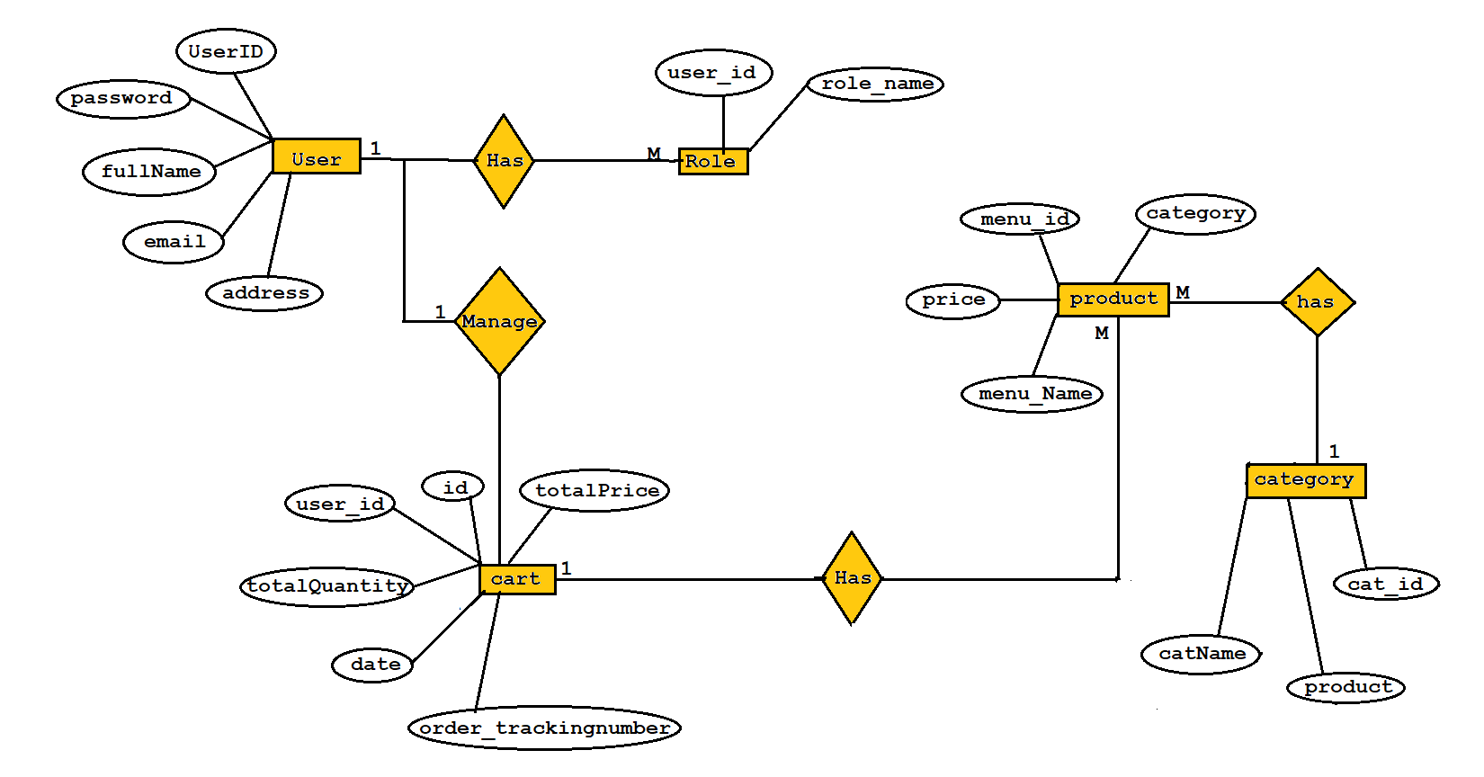
E R Diagram

Slide 7
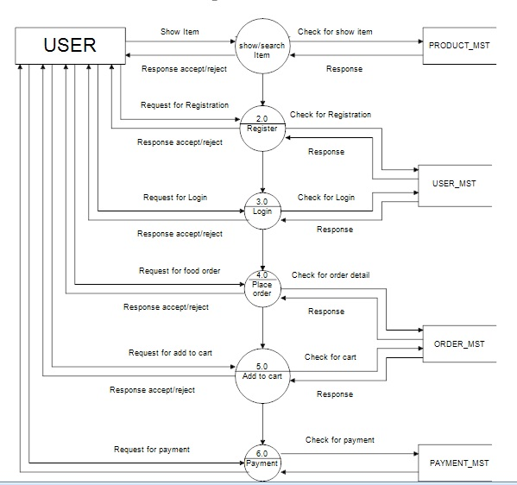
User Level Data Flow Diagram

Slide 8
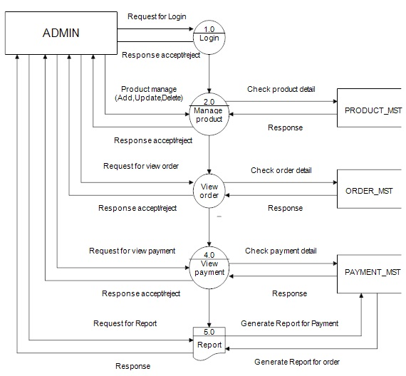
Admin Level DFD

Slide 9
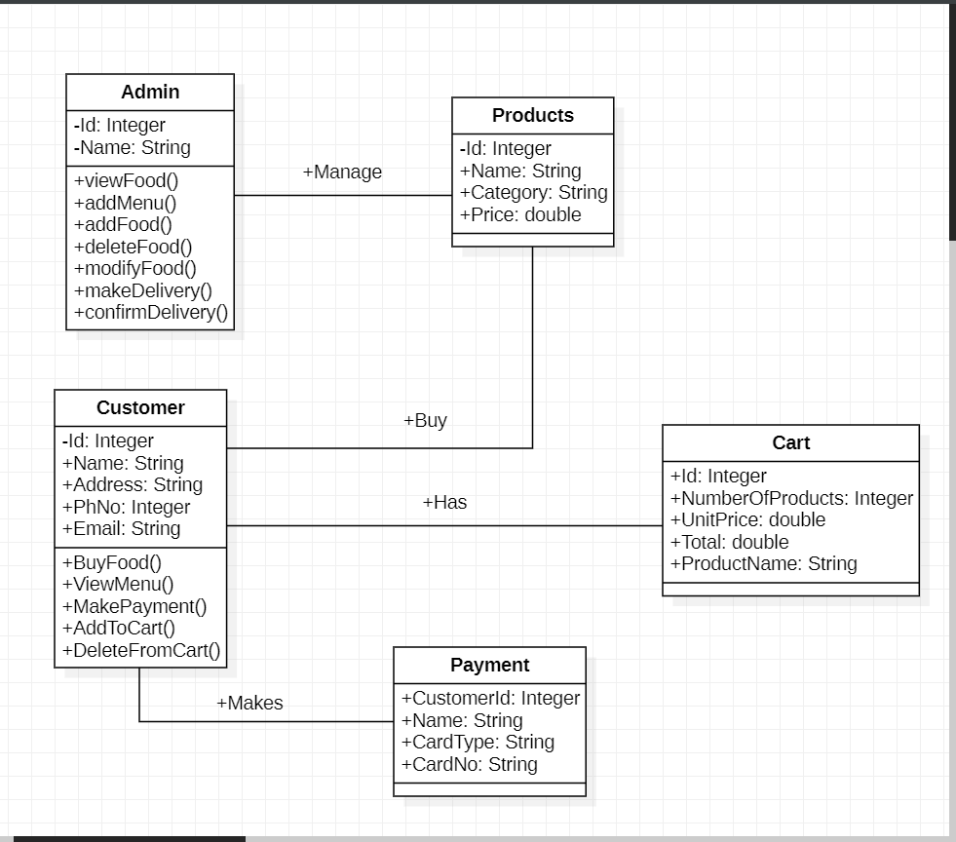
Class Diagram

Slide 10
Screen Shots

Slide 11
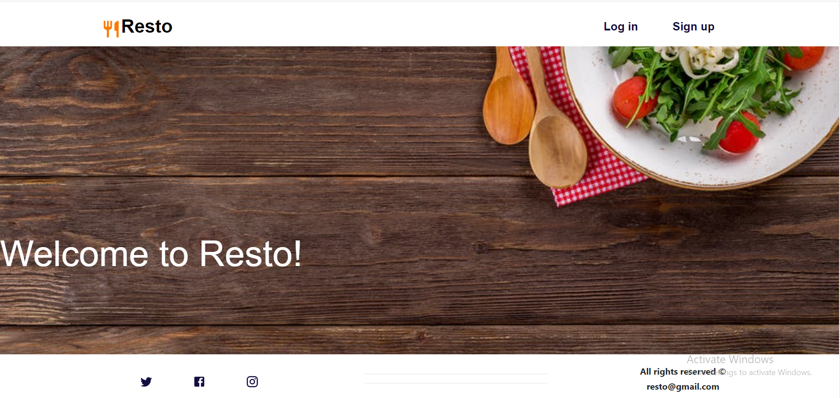
Home Page

Slide 12
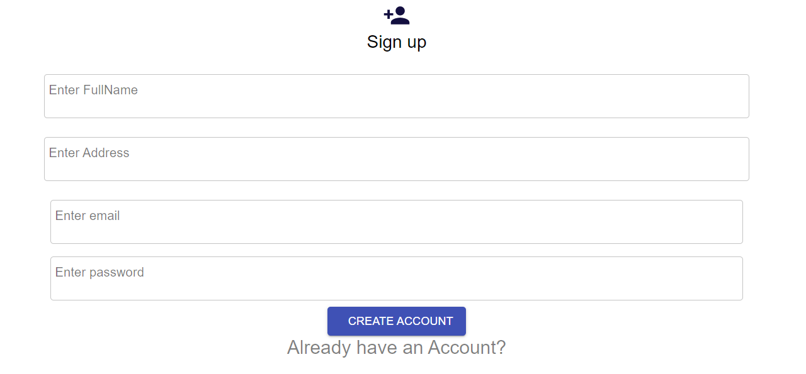
Registration Page

Slide 13
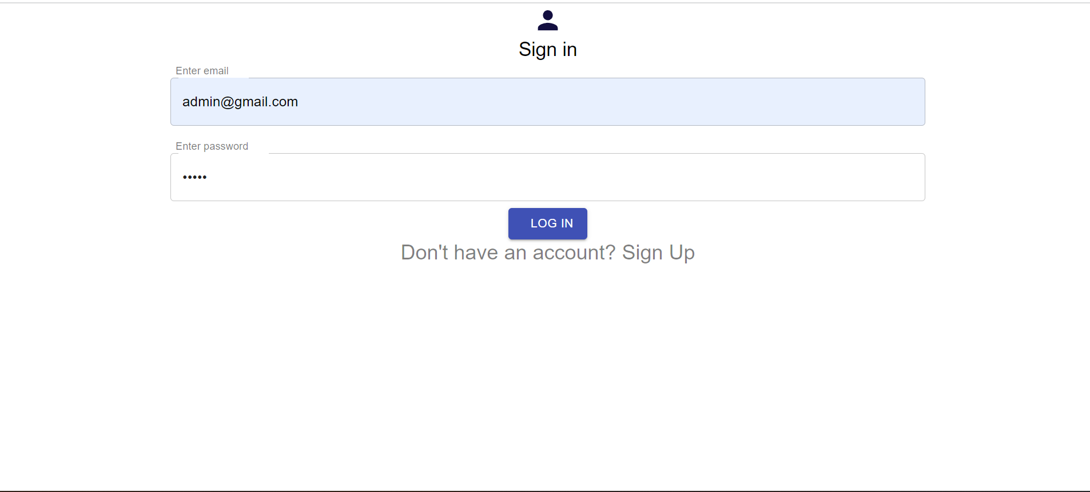
Login Page

Slide 14
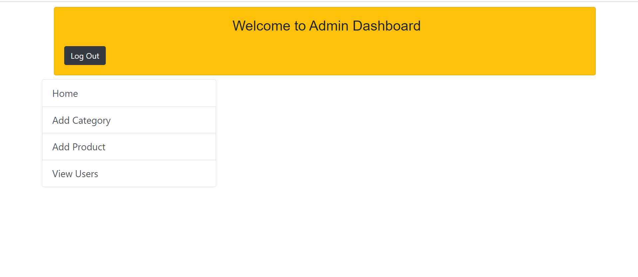
ADMIN INTERFACE PAGE

Slide 15
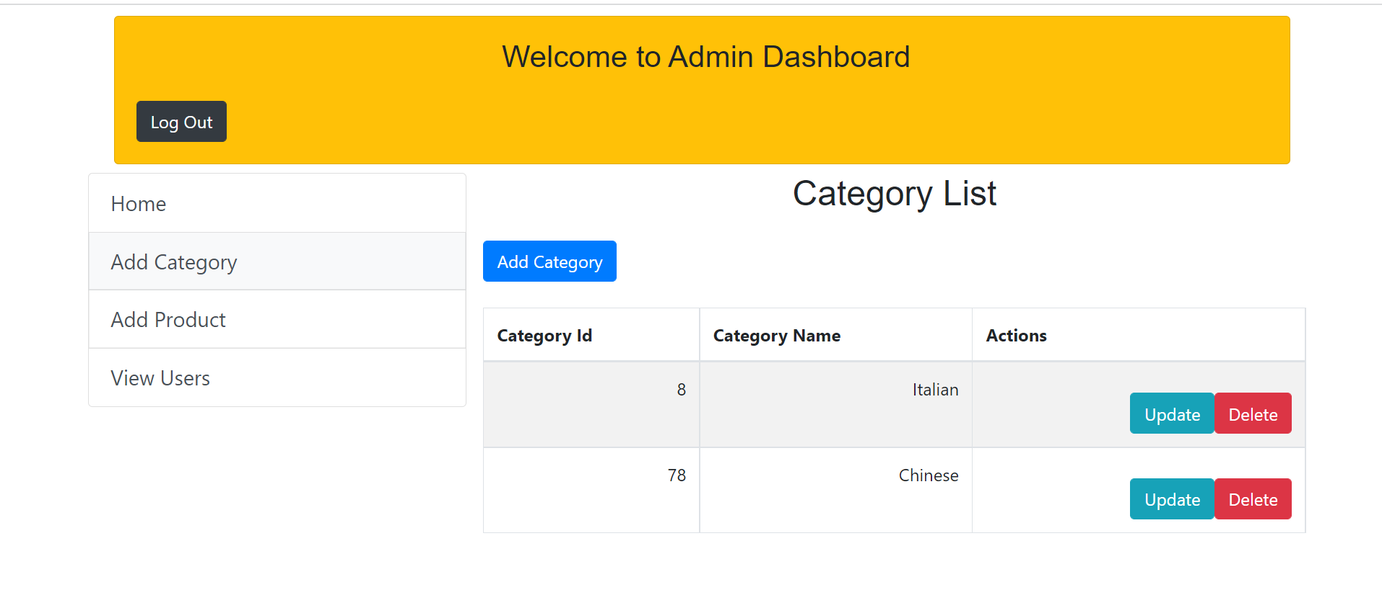
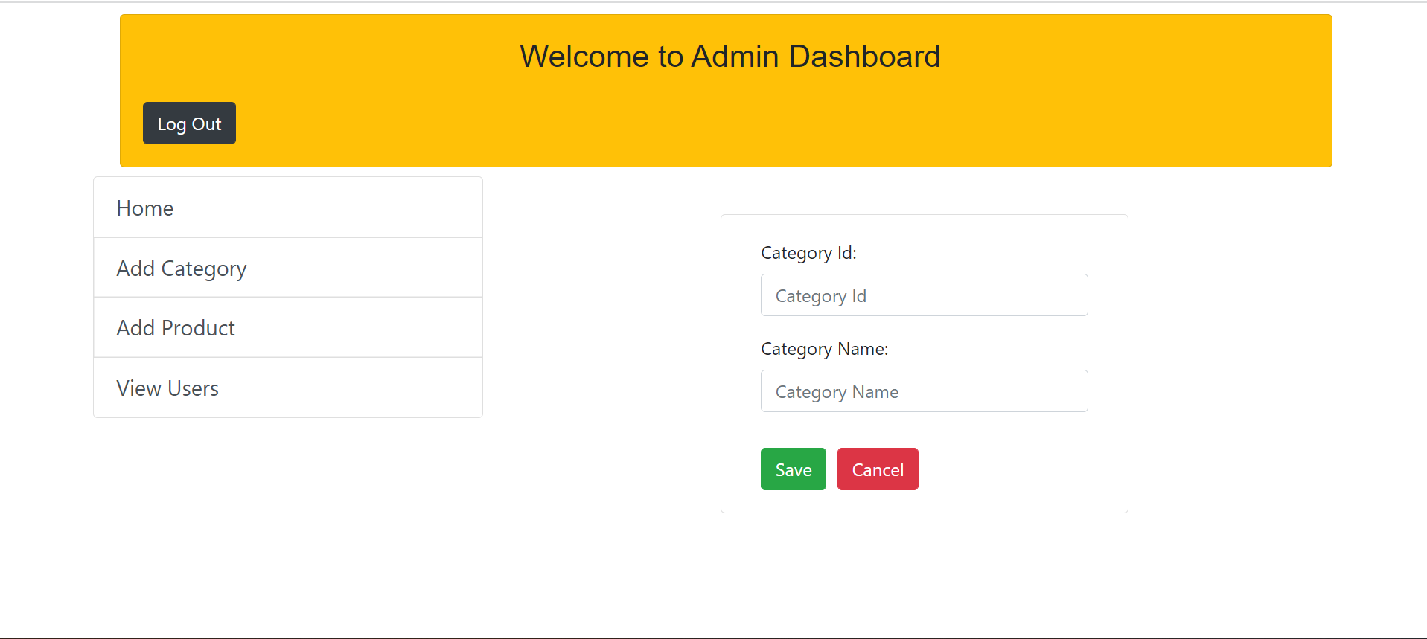

Slide 16
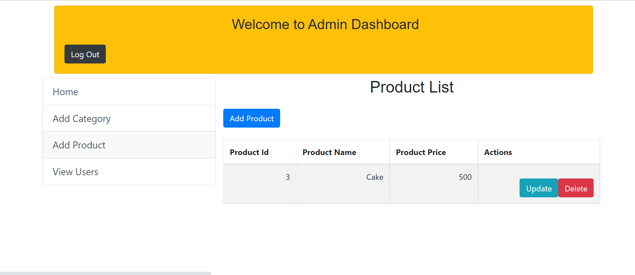
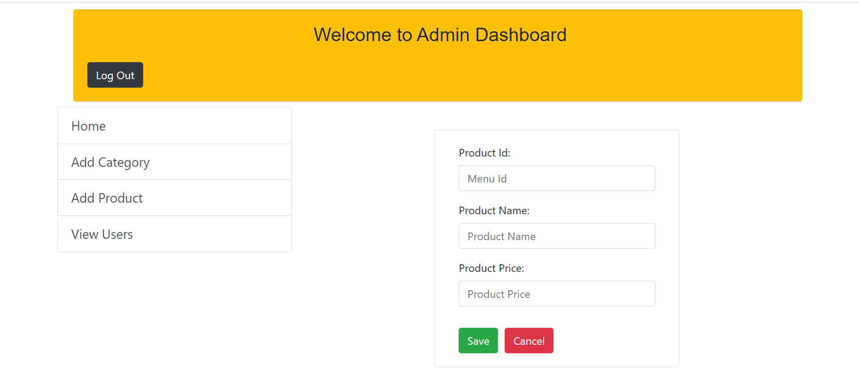

Slide 17
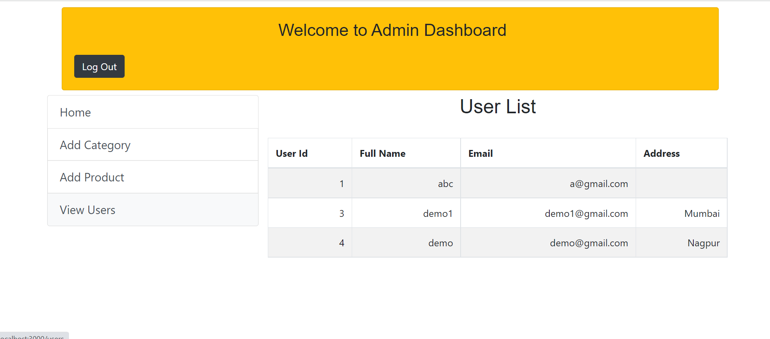

Slide 18
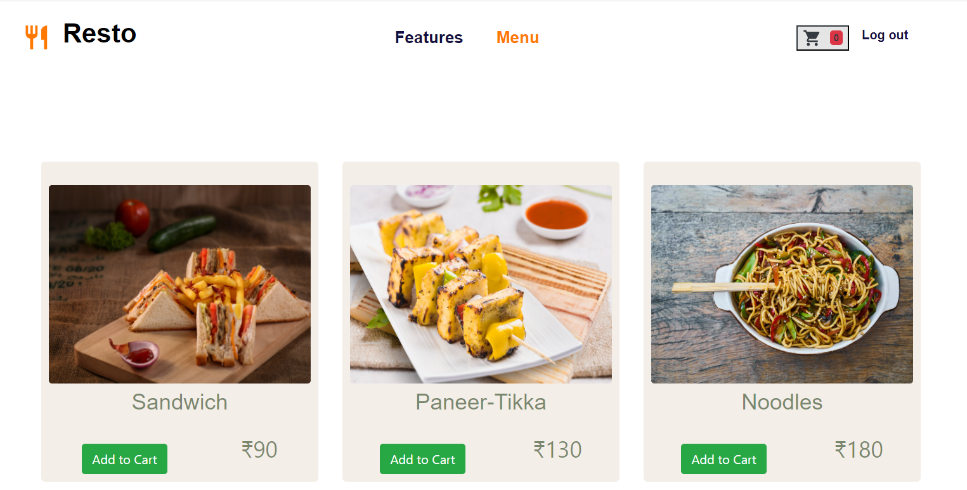
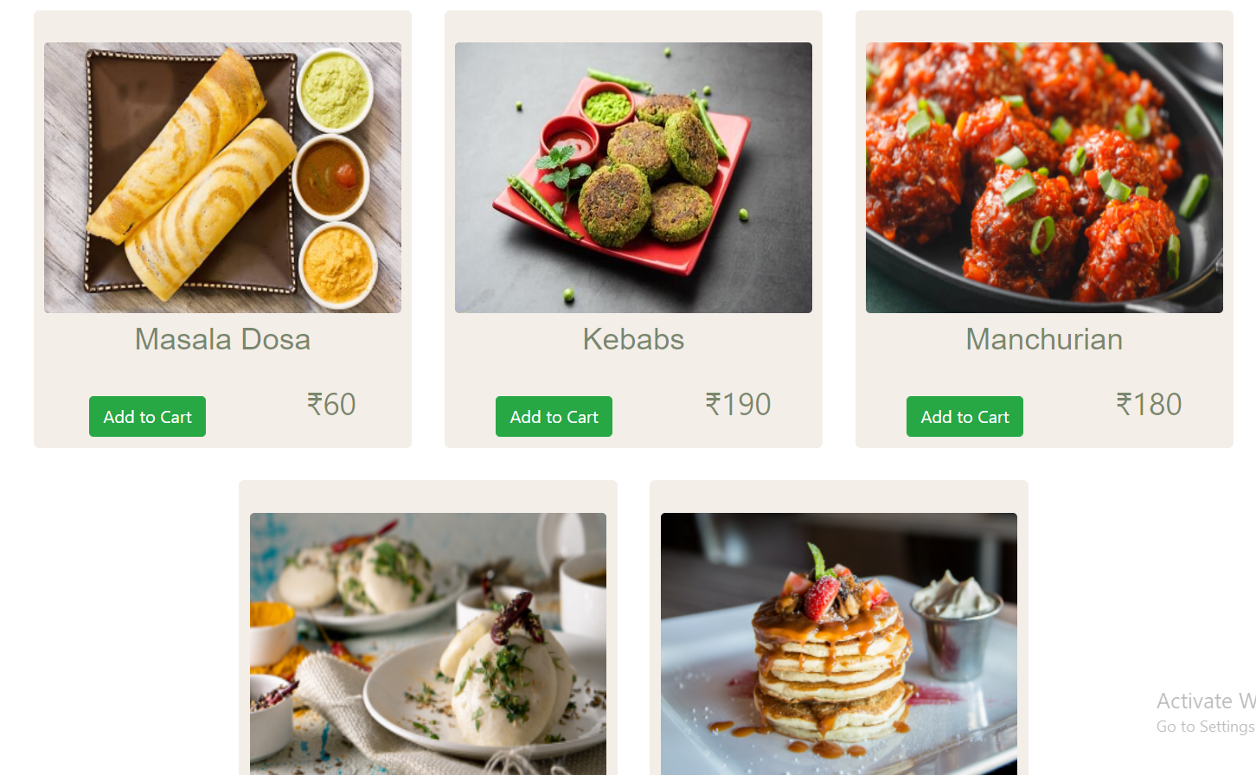
Menu Page

Slide 19
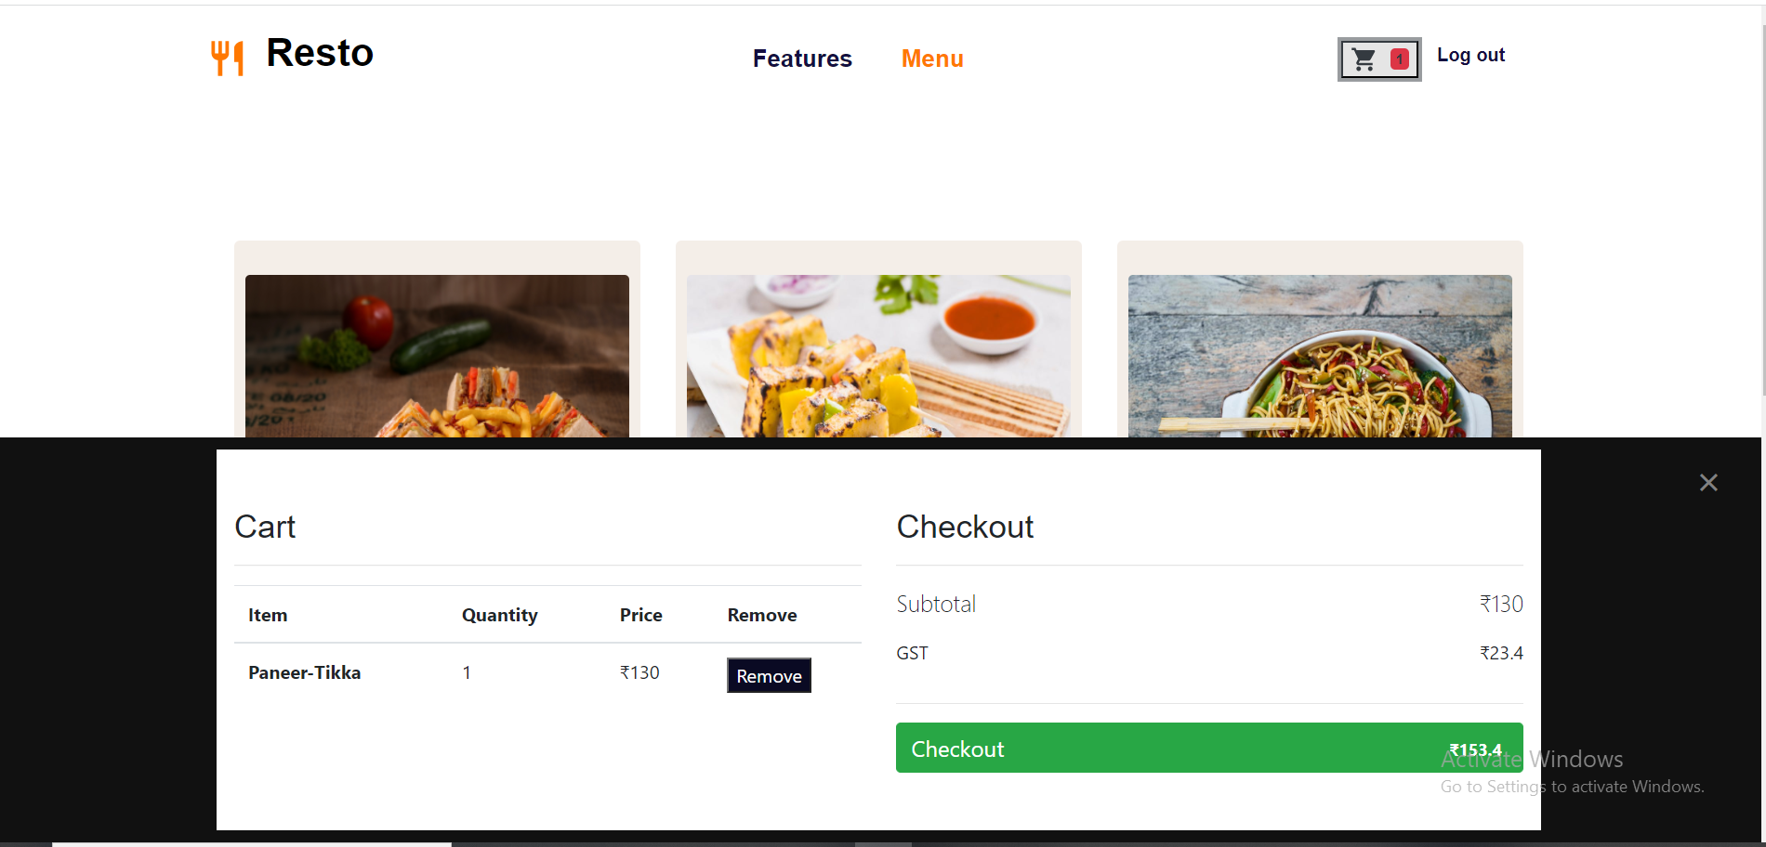
Cart Page

Slide 20
Advantages
Easy Communicative
Time Saving
Things on Click
User Friendly
Portable

Slide 21
Disadvantages
Cost Increase
Not getting Fine Dine Experience
Sometimes Order might get delayed Delivery

Slide 22
Conclusion
Online Food Ordering system is done to help and solve one of the important problems of customer of the standing in queues and waiting for orders . Customers using the internet and phone can place order from anywhere and pick it up as per their convenience. Thus, implementation of Online Food Ordering system is done to help and solve problems of customers as well as restaurant owners.

Slide 23
Future Enhancement
This Project can be enhanced further by adding various types of functionalities like ordering linking different restaurants together, giving facility to customer to give suggestions to add products of more variety, getting a particular type of packaging.
The application is flexible enough to be modified and implemented as per future requirements.
We tried our best to present this free and user friendly website to our audience.

Slide 24
References
https://www.javatpoint.com/java-mail-api-tutorial
https://www.w3schools.com/
https://www.researchgate.net/publication/350430883_ONLINE_FOOD_ORDERING_SYSTEM
https://www.slideshare.net/FatimaQayyum1/srs-software-requirement-specification-document
https://www.coursehero.com/file/53977776/food-ordering-docx/
https://www.scribd.com/oauth

Slide 25
Thank You

